Slide 1
Home Food Delivery App
Group 27 members: Wasay Ahmed (wahmed9), Christian Gutierrez (cgutie38), Jordan Nguyen (jtn3), Natalie Reyes (nreyes28)

Slide 2

Project Description
Home Food Delivery is similar to Uber Eats
Instead of serving restaurants, this app is dedicated toward serving home cooked meals to customers.

Slide 3
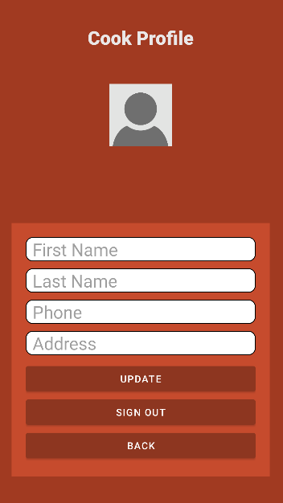
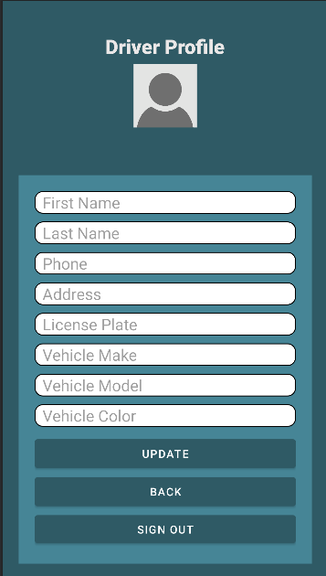
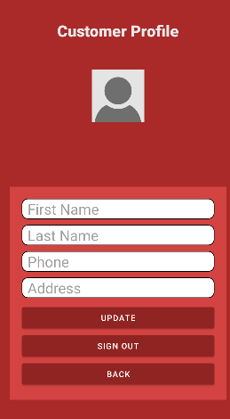
Capabilities of Users
Cook Users
Driver Users
Customer Users
Cooks: Manage order menu and availability status, accepts orders from customers, see order details
Customers: Create new orders, rate cooks/drivers
Drivers: Accepts orders from cooks, uses google maps to view cook/customer destinations

Slide 4
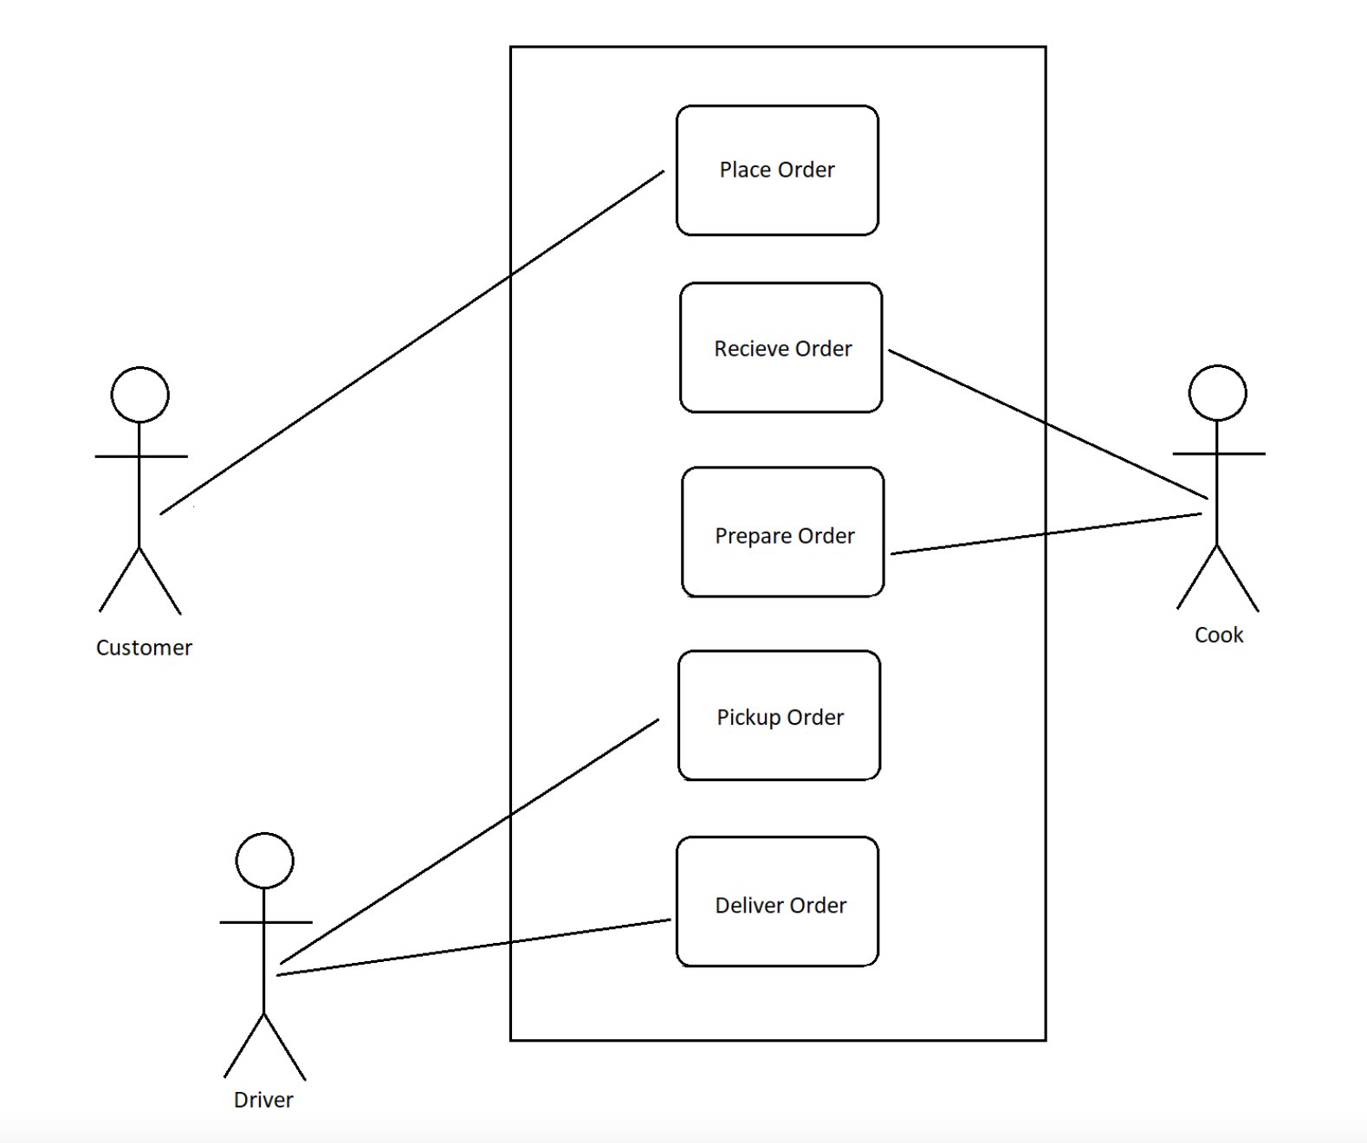
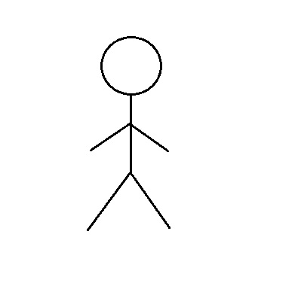
Scenario Diagram
Use Case Diagram
Menu
Order Details
Cook
Main Page with Active Orders
Customer
Completed Orders
Driver
Delivery

Slide 5
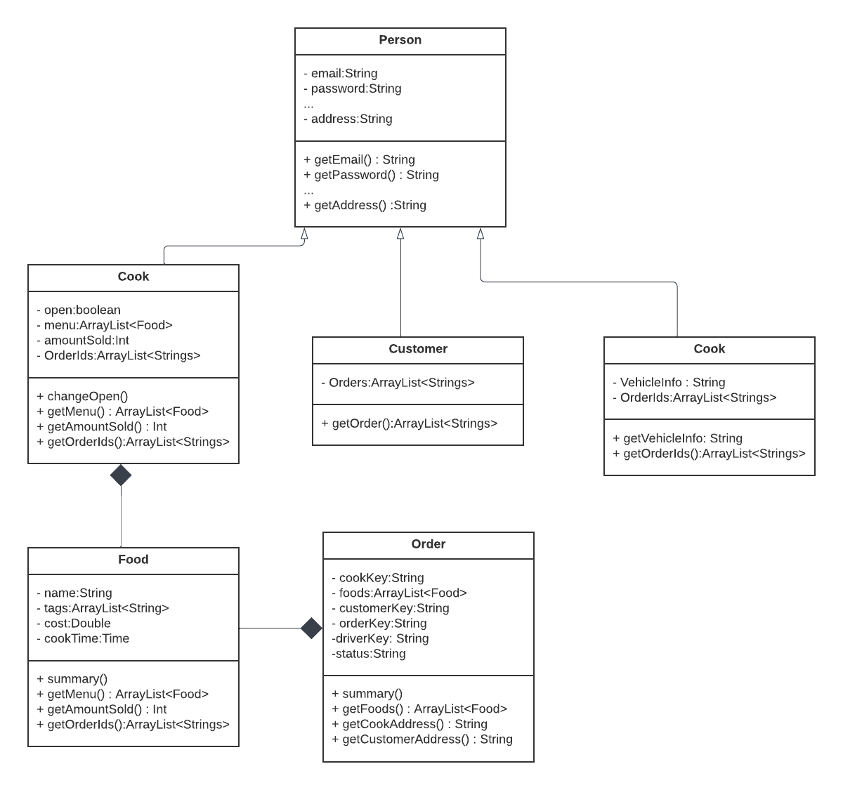
UML

Slide 6
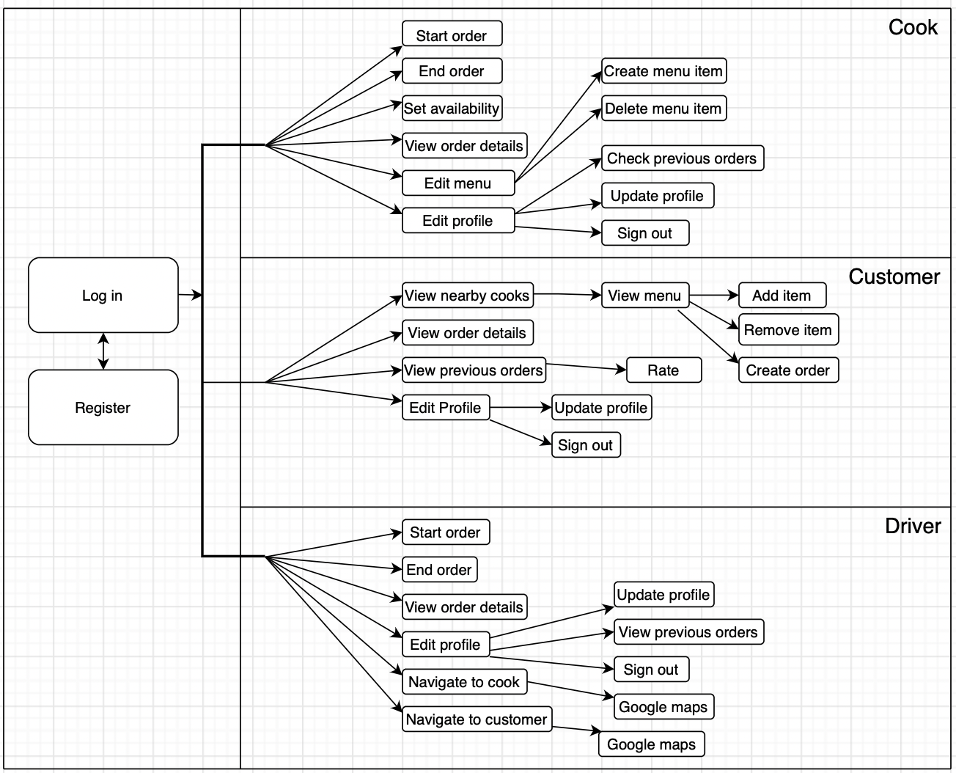
Activity Diagram

Slide 7
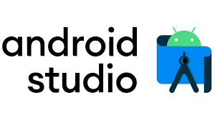


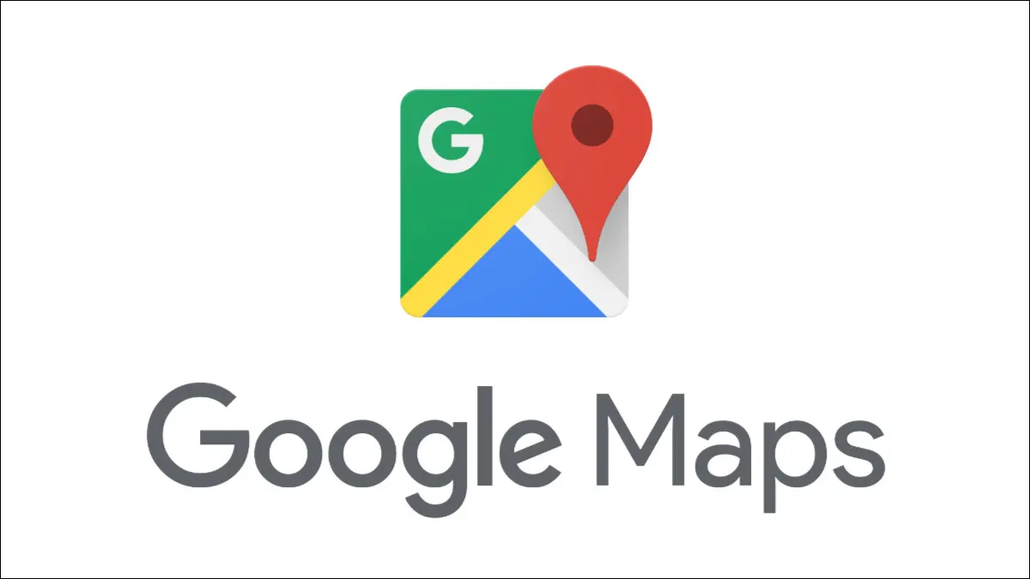
Technology Used
Android Studio
Java
XML
Google Firebase
Google Maps

Slide 8
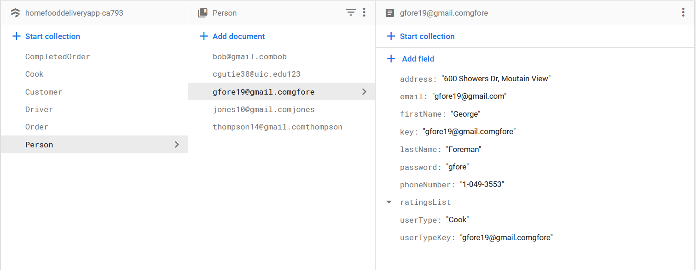
Cloud Firestore Database
Cloud Firebase is a NoSQL database. The database stores and syncs data between all three users in real time. Each user type and order type has its own collection where their data is stored.

Slide 9
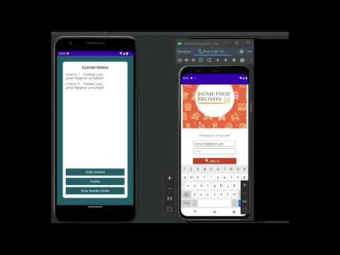
Demo
https://youtu.be/b0HyVivwyVg

